Slide 1



Noida Institute of Engineering and Technology, Greater Noida
Database Design & Normalization
Unit: 3
DBMS
Dr. Naina Pal
Assistant Professor
IT
Course Details (B Tech 4th Sem)

Slide 2
Brief Introduction of Faculty member
Name: Dr. Naina Pal
Qualification: B.Tech(IT), M.Tech (CSE), PhD (CSE)
Area of Research: Machine learning, K-means, Networking
Contact Details:
Email: naina.pal@niet.co.in

Slide 3
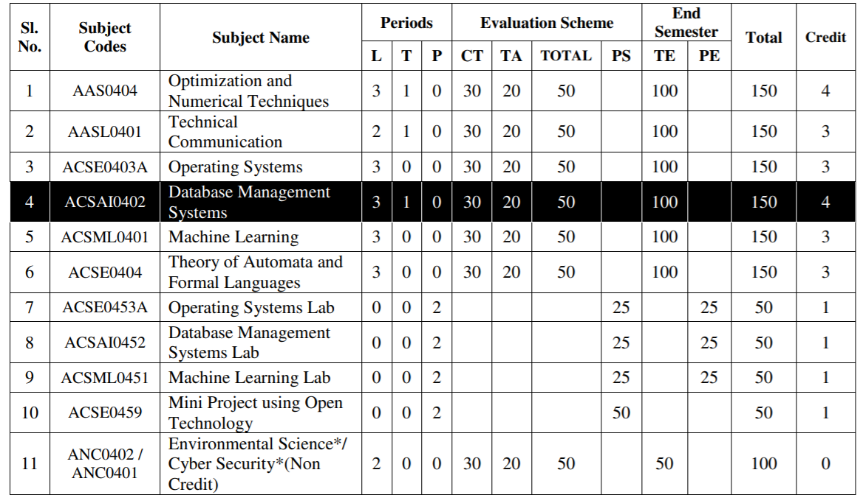
Evaluation Scheme

Slide 4
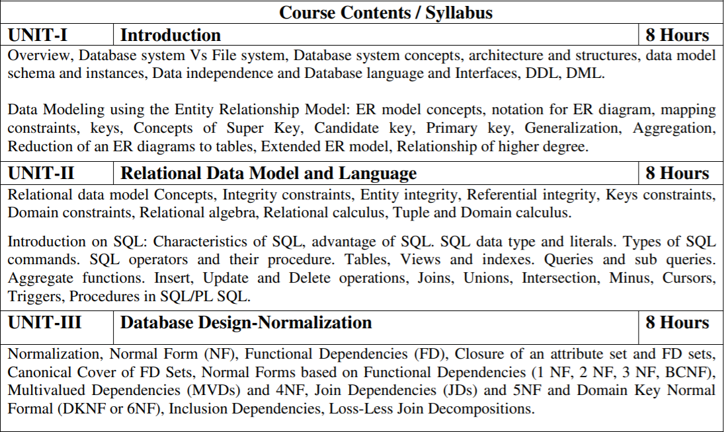
Subject Syllabus

Slide 5
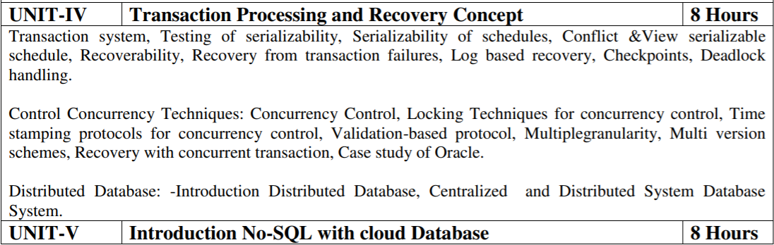
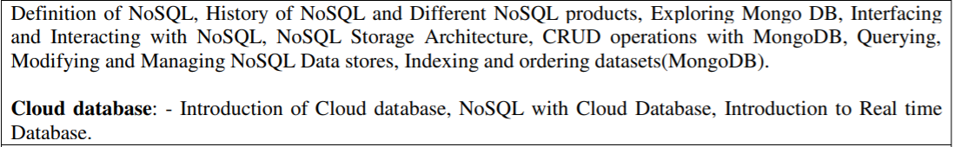
Subject Syllabus

Slide 6
Branch wise Application
DBMS can be used in :
Finance
Social Media Sites
Human Resource Management
Manufacturing
Credit card transactions

Slide 7
Course Objective
List and explain the fundamental concepts of a relational database system
Knowledge of DBMS, both in terms of use and implementation/design.
Experience with SQL and Manipulate a database using SQL
Increased proficiency with the programming language C++.
Experience working as part of team v Experience with analysis and design of (DB) software
Assess the quality and ease of use of data modeling and diagramming tools
Utilize a wide range of features available in a DBMS package.

Slide 8
Course Outcome
S. NO. | Course Outcomes | Blooms’ Taxonomy
ACSAI0402.1 | Apply knowledge of database for real life applications. | K3
ACSAI0402.2 | Apply query processing techniques to automate the real time problems of databases. | K3, K4
ACSAI0402.3 | Identify and solve the redundancy problem in database tables using normalization | K2, K3
ACSAI0402.4 | Understand the concepts of transactions, their processing so they will familiar with broad range of database management issues including data integrity, security and recovery. | K2, K4
ACSAI0402.5 | Design, develop and implement a small database project using database tools. | K3, K6

Slide 9
Program Outcomes (POs)
Engineering Graduates will be able to:
1. Engineering knowledge: Apply the knowledge of mathematics, science, engineering fundamentals, and an engineering specialization to the solution of complex engineering problems.
2. Problem analysis: Identify, formulate, review research literature, and analyze complex engineering problems reaching substantiated conclusions using first principles of mathematics, natural sciences, and engineering sciences.
3. Design/development of solutions: Design solutions for complex engineering problems and design system components or processes that meet the specified needs with appropriate consideration for the public health and safety, and the cultural, societal, and environmental considerations.
4. Conduct investigations of complex problems: Use research-based knowledge and research methods including design of experiments, analysis and interpretation of data, and synthesis of the information to provide valid conclusions.

Slide 10
Program Outcomes (POs)
Contd..
5. Modern tool usage: Create, select, and apply appropriate techniques, resources, and modern engineering and IT tools including prediction and modeling to complex engineering activities with an understanding of the limitations.
6. The engineer and society: Apply reasoning informed by the contextual knowledge to assess societal, health, safety, legal and cultural issues and the consequent responsibilities relevant to the professional engineering practice.
7. Environment and sustainability: Understand the impact of the professional engineering solutions in societal and environmental contexts, and demonstrate the knowledge of, and need for sustainable development.
8. Ethics: Apply ethical principles and commit to professional ethics and responsibilities and norms of the engineering practice.

Slide 11
Program Outcomes (POs)
Contd..
9. Individual and team work: Function effectively as an individual, and as a member or leader in diverse teams, and in multidisciplinary settings.
10. Communication: Communicate effectively on complex engineering activities with the engineering community and with society at large, such as, being able to comprehend and write effective reports and design documentation, make effective presentations, and give and receive clear instructions.
11. Project management and finance: Demonstrate knowledge and understanding of the engineering and management principles and apply these to one’s own work, as a member and leader in a team, to manage projects and in multidisciplinary environments.
12. Life-long learning: Recognize the need for, and have the preparation and ability to engage in independent and life-long learning in the broadest context of technological change.

Slide 12
COs and POs Mapping
 | PO1 | PO2 | PO3 | PO4 | PO5 | PO6 | PO7 | PO8 | PO9 | PO10 | PO11 | PO12
ACSAI0402.1 | 2 | 2 | 3 | 3 | 3 | 2 | 3 | 2 | 2 | 2 | 2 | 3
ACSAI0402.2 | 3 | 3 | 3 | 2 | 2 | 2 | 2 | 2 | 2 | 2 | 2 | 3
ACSAI0402.3 | 2 | 3 | 3 | 3 | 3 | 2 | 2 | 2 | 2 | 2 | 2 | 2
ACSAI0402.4 | 2 | 3 | 2 | 2 | 2 | 2 | 2 | 2 | 2 | 3 | 2 | 2
ACSAI0402.5 | 2 | 3 | 2 | 2 | 2 | 3 | 2 | 2 | 3 | 2 | 2 | 2
AVG | 2.20 | 2.80 | 2.60 | 2.40 | 2.40 | 2.20 | 2.20 | 2.00 | 2.20 | 2.20 | 2.00 | 2.40

Slide 13
Program Specific Outcomes
On successful completion of graduation degree the Computer Science & Engineering graduates will be able to:
PSO1: | Work as a software developer, database administrator, tester or networking engineer for providing solutions to the real world and industrial problems. ​
PSO2: | Apply core subjects of information technology related to data structure and algorithm, software engineering, web technology, operating system, database and networking to solve complex IT problems. ​
PSO3: | Practice multi-disciplinary and modern computing techniques by lifelong learning to establish innovative career.
PSO4: | Work in a team or individual to manage projects with ethical concern to be a successful employee or employer in IT industry.

Slide 14
COs and PSOs Mapping
 | Program Specific Outcomes
 | PSO1 | PSO2 | PSO3 | PSO4
ACSAI0402.1 | 3 | 1 | 3 | 1
ACSAI0402.2 | 3 | 1 | 3 | 1
ACSAI0402.3 | 3 | 1 | 3 | 1
ACSAI0402.4 | 3 | 1 | 3 | 1
ACSAI0402.5 | 3 | 1 | 3 | 1
AVG | 3.00 | 1.00 | 3.00 | 1.00

Slide 15

Program Educational Objectives
PEO1: To have an excellent scientific and engineering breadth so as to comprehend, analyze, design and provide sustainable solutions for real-life problems using state-of-the-art technologies.
PEO2:To have a successful career in industries, to pursue higher studies or to support entrepreneurial endeavors and to face global challenges.
PEO3:To have an effective communication skills, professional attitude, ethical values and a desire to learn specific knowledge in emerging trends, technologies for research, innovation and product development and contribution to society.
PEO4: To have life-long learning for up-skilling and re-skilling for successful professional career as engineer, scientist, entrepreneur and bureaucrat for betterment of society

Slide 16
Prerequisite and Recap
There is No prerequisite for learning DBMS from scratch.
Having knowledge of basic mathematics like - SUM, DIFFERENCE, AVERAGE, MEAN, MEDIAN, MODE, etc will definitely be a plus point.
Having knowledge on Set Theory will help.
The proper understanding of data structures (B and B+ trees) will help you to understand the DBMS quickly.

Slide 17

Result Analysis

Slide 18



Question Paper Template

Slide 19
Question Paper Template
 |  | SECTION – A |  | CO
 | Attempt all parts- |  | [10×1=10]
 | 1-a. | Question- | (1)
 | 1-b. | Question- | (1)
 | 1-c. | Question- | (1)
 | 1-d. | Question- | (1)
 | 1-e. | Question- | (1)
 | 1-f. | Question- | (1)
 | 1-g. | Question- | (1)
 | 1-h. | Question- | (1)
 | 1-i. | Question- | (1)
 | 1-j. | Question- | (1)
2. | Attempt all parts- |  | [5×2=10] | CO
 | 2-a. | Question- | (2)
 | 2-b. | Question- | (2)
 | 2-c. | Question- | (2)
 | 2-d. | Question- | (2)
 | 2-e. | Question- | (2)
SECTION – B |  |  |  | CO
3. | Answer any five of the following- |  | [5×6=30]
 | 3-a. | Question- | (6)
 | 3-b. | Question- | (6)
 | 3-c. | Question- | (6)
 | 3-d. | Question- | (6)
 | 3-e. | Question- | (6)
 | 3-f. | Question- | (6)
 | 3-g. | Question- | (6)
SECTION – C |  |  |  | CO
4 | Answer any one of the following- |  | [5×10=50]
 | 4-a. | Question- | (10)
 | 4-b. | Question- | (10)
5. | Answer any one of the following-
 | 5-a. | Question- | (10)
 | 5-b. | Question- | (10)
6. | Answer any one of the following-
 | 6-a. | Question- | (10)
 | 6-b. | Question- | (10)
7. | Answer any one of the following-
 | 7-a. | Question- | (10)
 | 7-b. | Question- | (10)
8. | Answer any one of the following-
 | 8-a. | Question- | (10)
 | 8-b. | Question- | (10)

Slide 20
Brief Introduction about the Subject
A database management system (DBMS) refers to the technology for creating and managing databases. DBMS is a software tool to organize (create, retrieve, update, and manage) data in a database.
The main aim of a DBMS is to supply a way to store up and retrieve database information that is both convenient and efficient. By data, we mean known facts that can be recorded and that have embedded meaning.
Usually, people use software such as DBASE IV or V, Microsoft ACCESS, or EXCEL to store data in the form of a database. A datum is a unit of data. Meaningful data combined to form information. Hence, information is interpreted data - data provided with semantics. MS. ACCESS is one of the most common examples of database management software.

Slide 21
Recap
Functional dependency
Types of Functional dependency

Slide 22

Topic 3 Objective
Inference rules

Slide 23
Inference Rules for Functional Dependencies
An inference rule is an assertion that we can apply to set of functional dependencies to derive other functional dependencies.
We denote by F the set of functional dependencies that are specified on relation schema R.
Inference rules are sound meaning that they are an immediate consequence of the definition of FD and that only FD that can be derived from a relation from a given set of FD using them to true.
So, inference rules can be used to find all the derived FD’s logically by a set of FD is true and complete.

Slide 24
Definition
Definition:
An FD X → Y is inferred from or implied by a set of dependencies F specified on R if X → Y holds in every legal relation state r of R; that is, whenever r satisfies all the dependencies in F, X → Y also holds in r.
Inference rules basically based on Armstrong axiom.
Armstrong Axiom basic inference rules are :-
1. IR1 (reflexive rule) : If X ⊇ Y, then X →Y.
2. IR2 (augmentation rule) : {X → Y} |= XZ → YZ.
3. IR3 (transitive rule): {X → Y, Y → Z} |= X → Z.
IR1, IR2, IR3 form a sound and complete set of inference rules

Slide 25
Armstrong Axiom Rules
There are three other inference rules that follow from IR1, IR2 and IR3.
They are as follows:
4. IR4 (decomposition, or projective, rule): {X → YZ} |=X → Y,
X →Z
5. IR5 (union, or additive, rule): {X → Y, X → Z} |=X → YZ.
6 . IR6 (pseudotransitive rule): {X → Y, WY → Z} |=WX → Z.
Note:- Rules from IR1 to IR3 are known as Armstrong Axiom rules. These rules are mainly used in FD to find complete set of all possible dependencies.

Slide 26
Question
Let us consider the Universal relation schema R = ( A, B, C, G, H, I ) and the set of functional dependencies F ={ A → B, A → C, CG → H, CG → I , B → H}.
Determines the other FD’s from given set of FD F.
Answer:-
Given F= { A → B, A → C, CG → H, CG → I , B → H}.
Since A → B and B → H hold, we apply the transitivity rule that A → H
Since CG → H and CG → I , the union rule implies that CG → HI.
Since A → C and CG → I , the pseudo-transitivity rule implies that AG → I holds
Since A → B and A→ C hold, we apply the union rules that A → BC
All possible FD are:-
F’= { A → B, A → C, CG → H, CG → I , B → H, A → H, CG → HI ,A →BC, AG → I }.

Slide 27
Conti………… (CO3)
Note:-
Armstrong axioms are complete. As for a given set F of functional dependencies, all FD implied by F can be inferred by using rules IR1 through IR3.
Armstrong axiom are also sound as to no additional FD or incorrect FD’s can be deduced from F by using inference rules.

Slide 28
Recap
Inference rules

Slide 29
Topic 4,5 Objective
Closure of Attribute set.
Definitions of Keys
Find the super key and candidate key from FD

Slide 30
Closure of a Attribute set
After finding a set of FD’s that are hold on a relation the next step is to find super key and candidate key for a relation and,
Also to test whether a set X is a super key, we must devise an algorithm for computing the set of attributes functionally determined by X.

Slide 31
Algorithm for Closure of a Attribute set
The set of attribute that are functionally dependent on the attribute X is called attribute closure of X and it can be represented by X^{+.}
Or
For each such set of attributes X, we determine the set X⁺ of attributes that are functionally determined by X based on F;
X⁺ is called the closure of X under F.
Algorithm :- Determining X⁺, the Closure of X under F .
Input: A set F of FDs on a relation schema R, and a set of attributes X, which is a subset of R.
X⁺ := X;
repeat
old X⁺ := X⁺;
for each functional dependency Y → Z in F do
if X⁺ ⊇ Y then X⁺ := X⁺ ∪ Z;
until (X⁺ = old X⁺);

Slide 32
Definitions of Keys and Attributes Participating in Keys
A super key of a relation schema R = {A1, A2, … , An} is a set of attributes S ⊆ R with the property that no two tuples t1 and t2 in any legal relation state r of R will have t1[S] = t2[S].
If a relation schema has more than one key, each is called a candidate key.
One of the candidate keys is designated to be the primary key, and the others are called secondary keys. In a practical relational database, each relation schema must have a primary key.
If no candidate key is known for a relation, the entire relation can be treated as a default super key.
An attribute of relation schema R is called a prime attribute of R if it is a member of some candidate key of R.
An attribute is called nonprime if it is not a prime attribute—that is, if it is not a member of any candidate key.

Slide 33
Find the super key and candidate key from FD
Definition :- The set of attribute whose closure of attribute is set of all attribute of a relation called super key of relation and if this is set of minimal of it is called of candidate key.
Formally say ,
Let R is the relation and X is the set of attribute over R.
If X⁺ determines all the attributes of R, then X is said to be super key, or candidate key of R.
To find the candidate key first find all the super key of a relation. (because the candidate key is a minimal set of super key).

Slide 34
Step to find the super key and candidate Key
So To identify super key and candidate key, We need to follow some steps,
Compute the closure for the attribute that combination of attribute on The LHS of FD,
If any closure includes all the attribute of given relation, then that can be denoted as a key for the relation(This would be the set of super key and candidate key).
When we indentify the super key using FD’s and it has extraneous attribute in the super key then,
Now applying the given FD and reduced the set of LHS elements
Repeat Step-4,Apply till the of element of the super key when it is not functionally determines all FD, If fail Stop, otherwise
We determines all FD from a exclusive attribute of super key is true is called candidate key

Slide 35
Example 3
Given R( X Y Z W) and FD= { XYZ → W, XY → ZW and X → YZW}. Find Candidate Key and Super Key.
Solution-
Step 1: Let us calculate the closure of XYZ+ = {X,Y,Z,W} (from the method we studied earlier)
Since XYZ closure is determining all the attributes of the table, hence it is Super Key
Step 2: Let us calculate the closure of XY+ = { X,Y,Z,W }
Since XY closure is determining all the attributes of the table, hence it is Super Key
Step 3: Let us calculate the closure of X+ {X,Y,Z,W}
Since X closure is determining all the attributes of the table, hence it is Super Key=

Slide 36
Cont..
From the above definition, XYZ is not a candidate key, as in Step 2 and 3 we found that XY and X are also Super Key (i.e., subset of XYZ are also SK which violate the definition)
XY is not a candidate key, as in Step 3 we found that X is also a Super Key (i.e., subset of XY are also SK which violate the definition)
X is the Candidate key: As X cannot be further subdivided, or X cannot have any subset.
Hence XYZ, XY, and X are all Super Key, while the only X is a candidate key.

Slide 37
Example 4
Given R( X Y Z W) and FD= { XY → Z, Z → YW, and W → X }. Find Candidate Key and Super Key.
Step 1: Let us calculate the closure of XY+ = XYZW (from the method we studied earlier).
Since XY closure is determining all the attributes of the table, hence it is Super Key.
Step 2: Let us calculate the closure of Z+ = ZYWX (from the method we studied earlier).
Since Z closure is determining all the attributes of the table, hence it is Super Key.
Step 3: Let us calculate the closure of W+ = WX (from the method we studied earlier).
Since X closure is not determining all the attributes of the table, hence it is Not Super Key, since it is not SK it can never be Candidate key

Slide 38
Cont..
As we have talked in the above step only for the super key, not for the candidate key.
Let us see the definition of Candidate Key again (Candidate Key is a Super Key whose no proper subset is a superkey)
From the above definition XY is a candidate key, as in Step 2 and 3 none of the subsets of XY i.e. either X or Y is Super Key.
Z is the Candidate key: As Z cannot be further subdivided, or Z cannot have any subset.
Hence XY and Z are Super Key, also XY and Z are a candidate key

Slide 39
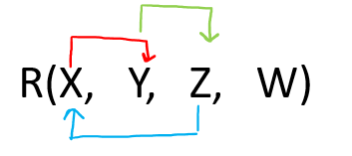
Example 5
Give R(X, Y, Z, W) and Set of Functional Dependency
FD = { X → Y, Y → Z, Z → X}.
The question is to calculate the candidate key and no. of candidate key in above relation R using a given set of FDs.
Solution- Let us construct an arrow diagram on R using FD
Candidate Key
Let us calculate the closure of W
W + = W (from the method we studied earlier)
Since, closure of W contains only W, hence it is not a candidate key.

Slide 40
Cont..
Let us check the combination of W, i.e. WX, WY, WZ.
a) W X + = W X Y Z ( from the method we studied earlier)
Since the closure of WX contains all the attributes of R, hence WX is Candidate Key
b) W Y + = W Y Z X (from the method we studied earlier)
Since the closure of WX contains all the attributes of R, hence WY is Candidate Key
c) W Z + = W Z X Y (from the method we studied earlier)
Since the closure of WX contains all the attributes of R, hence WZ is Candidate Key
From the definition of Candidate Key (Candidate Key is a Super Key whose no proper subset is a Super key)
We can say that any further combination of WX, WY, WZ, i.e. WXY, WXYZ, WYZ, WZX will be Super Key but not a candidate key.
Therefore, there are THREE Candidate keys WX, WY, WZ.

Slide 41
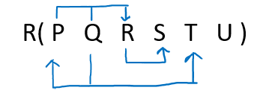
Example 6
Give R( P, Q, R, S, T, U) and Set of Functional Dependency FD = { PQ → R, R → S, Q → PT}. The question is to calculate the candidate key and no. of candidate key in above relation R using a given set of FDs.
Solution- Let us construct an arrow diagram on R using FD
Let us calculate closure of QU using FD = { PQ → R, R → S, Q → PT}.
QU+ = QUPTRS
Since the closure of QU contains all the attributes of R, hence it is QU Candidate Key.
From the definition of Candidate Key(Candidate Key is a Super Key whose no proper subset is a Super key)
We can say that any further combination of QU, i.e. QUP, QUR, QUS, QUT, etc. will be Super Key but not a candidate key.
Therefore. there is only ONE Candidate key QU.

Slide 42
Example
Problem: Let R = (A, B, C, D, E, F) be a relation scheme with the following dependencies-
F= {C → F
E → A
EC → D
A → B
Which of the following is a key for R?
CD
EC
AE
AC
Also, determine the total number of candidate keys and super keys.

Slide 43
Example
Solution-
We will find candidate keys of the given relation in the following steps-
Step-01: Determine all essential attributes of the given relation.
Essential attributes of the relation are- C and E.
So, attributes C and E will definitely be a part of every candidate key.
Step-02: Now, We will check if the essential attributes together can determine all remaining non-essential attributes.
To check, we find the closure of CE.
So, we have- { CE } = { C , E }
= { C , E , F } ( Using C → F )
= { A , C , E , F } ( Using E → A )
= { A , C , D , E , F } ( Using EC → D )
= { A , B , C , D , E , F } ( Using A → B )

Slide 44
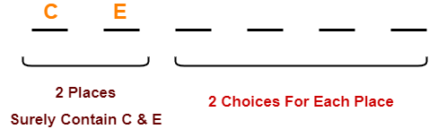
Example
We conclude that CE can determine all the attributes of the given relation.
So, CE is the only possible candidate key of the relation.
Thus, Option (B) is correct.
Total Number of Candidate Keys-
Only one candidate key CE is possible.
Total Number of Super Keys-
There are total 6 attributes in the given relation of which-
There are 2 essential attributes- C and E.
Remaining 4 attributes are non-essential attributes.
Essential attributes will be definitely present in every key.
Non-essential attributes may or may not be taken in every super key.
So, number of super keys possible = 2 x 2 x 2 x 2 = 16.
Thus, total number of super keys possible = 16.

Slide 45
Recap
Closure of Attribute set.
Definitions of Keys
Find the super key and candidate key from FD

Slide 46
Topic 6 Objective
Equivalence set of FD
Minimal cover, Canonical cover of FD

Slide 47
Equivalence Sets of FDs
Definition.
A set of functional dependencies F is said to cover another set of functional dependencies E if every FD in E is also in F+; that is, if every dependency in E can be inferred from F; alternatively, we can say that E is covered by F.
Means,
Two sets of FDs F and E are equivalent if:
- every FD in F can be inferred from E, and
- every FD in E can be inferred from F
Hence, F and E are equivalent if F ⁺ = E ⁺
F and E are equivalent if F covers E and E covers F

Slide 48
Step to Equivalence Sets of FDs
We can determine whether F covers E by calculating X⁺ with respect to F for each FD X → Y in E,
And then checking whether this X⁺ includes the attributes in Y. If this is the case for every FD in E, then F covers E. We determine whether E and F are equivalent by checking that E covers F and F covers E.
Note
If F and G are the two sets of functional dependencies, then following 3 cases are possible-
If all FDs of E can be derived from FDs present in F, we can say that F ⊃ E.
If all FDs of F can be derived from FDs present in E, we can say that E ⊃ F.
3. If 1 and 2 both are true, F=E.

Slide 49
PRACTICE PROBLEM EQUIVALENCE OF FUNCTIONAL DEPENDENCIES-
A relation R (A , C , D , E , H) is having two functional dependencies sets F and G as shown-
Set F- { A → C, AC → D, E → AD, E → H }
Set G- { A → CD, E → AH }
Which of the following holds true?
(A) G ⊇ F
(B) F ⊇ G
(C) F = G
(D) All of the above

Slide 50
PRACTICE PROBLEM EQUIVALENCE OF FUNCTIONAL DEPENDENCIES-
Solution-
Determining whether F covers G-
Step-01:
(A)⁺ = { A , C , D } // closure of left side of A → CD using set G
(E)⁺ = { A , C , D , E , H } // closure of left side of E → AH using set G
Step-02:
(A)⁺ = { A , C , D } // closure of left side of A → CD using set F
(E)⁺ = { A , C , D , E , H } // closure of left side of E → AH using set F
Step-03:
Comparing the results of Step-01 and Step-02, we find-
Functional dependencies of set F can determine all the attributes which have been determined by the functional dependencies of set G.
Thus, we conclude F covers G i.e. F ⊇ G.

Slide 51
PRACTICE PROBLEM EQUIVALENCE OF FUNCTIONAL DEPENDENCIES-
Determining whether G covers F-
Step-01:
(A)⁺ = { A , C , D } // closure of left side of A → C using set F
(AC)⁺ = { A , C , D } // closure of left side of AC → D using set F
(E)⁺ = { A , C , D , E , H } // closure of left side of E → AD and E → H using set F
Step-02:
(A)⁺ = { A , C , D } // closure of left side of A → C using set G
(AC)⁺ = { A , C , D } // closure of left side of AC → D using set G
(E)⁺ = { A , C , D , E , H } // closure of left side of E → AD and E → H using set G
Step-03:
Comparing the results of Step-01 and Step-02, we find-
Functional dependencies of set G can determine all the attributes which have been determined by the functional dependencies of set F.
Thus, we conclude G covers F i.e. G ⊇ F.

Slide 52
PRACTICE PROBLEM EQUIVALENCE OF FUNCTIONAL DEPENDENCIES-
Determining whether both F and G cover each other-
From Step-01, we conclude F covers G.
From Step-02, we conclude G covers F.
Thus, we conclude both F and G cover each other i.e. F = G.
Thus, Option (D) is correct.

Slide 53
Minimal cover, Canonical cover of FD

Slide 54
Need of minimal cover of Functional Dependencies
Whenever a user updates database the system must check whether any FD are getting violated in the process, if there is a violation of dependencies in the new database state the system must rollback. If working with a huge set of FD can cause unnecessary added computational time .
Remove the extraneous attribute in FD set and also remove the redundant FD in F and get standard from of FD.
So we can reduce the effort spent in checking for violation by testing a simplified set of FDs, canonical cover comes to play big role for remove redundant FD and find the standard form of FD.

Slide 55
Continue…… (CO3)
A minimal cover of a set of functional dependencies E is a set of functional dependencies F that satisfies the property that every dependency in E is in the closure F ⁺ of F.
In addition, this property is lost if any dependency from the set F is removed; F must have no redundancies in it, and the dependencies in F are in a standard form.

Slide 56
Definition of minimal cover
Definition:- An attribute in a functional dependency is considered an extraneous attribute if we can remove it without changing the closure of the set of dependencies.
Formally, given F, the set of functional dependencies, and a functional dependency X → A in F, attribute Y is extraneous in X if Y ⊂ X, and F logically implies (F − (X → A) ∪ { (X − Y) → A } ).
We can formally define a set of functional dependencies F to be minimal if it satisfies the following conditions: -
1. Every dependency in F has a single attribute for its right-hand side.
2. We cannot replace any dependency X → A in F with a dependency Y → A, where Y is a proper subset of X, and still have a set of dependencies that is equivalent to F.
3. We cannot remove any dependency from F and still have a set of dependencies that is equivalent to F.

Slide 57
Algorithm for Minimal cover
Algorithm:- Finding a Minimal Cover F for a Set of Functional Dependencies E
Input: A set of functional dependencies E.
1. Set F := E.
2. Replace each functional dependency X → {A1, A2, … , An} in F by the n functional dependencies X →A1, X →A2, … , X → An.
3. For each functional dependency X → A in F for each attribute B that is an element of X if { {F − {X → A} } ∪ { (X − {B} ) → A} } is equivalent to F then replace X → A with (X − {B} ) → A in F.
(* The above constitutes a removal of the extraneous attribute B from X *)
4. For each remaining functional dependency X → A in F if {F − {X → A} } is equivalent to F, then remove X → A from F.
(*This constitutes removal of a redundant functional dependency X → A from F when possible*)

Slide 58
Example on Minimal Cover
Find the minimal cover of the set of functional dependencies given;
{A → C, AB → C, C → DI, CD → I, EC → AB, EI → C}
Solution-
Simple properties/steps of minimal cover:
1. Right Hand Side (RHS) of all FDs should be single attribute.
2. Remove extraneous attributes.
3. Eliminate redundant functional dependencies.
1. Right Hand Side (RHS) of all FDs should be single attribute. So we write F as F1, as follows;
F1 = {A → C, AB → C, C → D, C → I, CD → I, EC → A, EC → B, EI → C}

Slide 59
Cont..
2. Remove extraneous attributes.
Extraneous attribute is a redundant attribute on the LHS of the functional dependency. In the set of FDs, AB → C, CD → I, EC → A, EC → B, and EI → C have more than one attribute in the LHS. Hence, we check one of these LHS attributes are extraneous or not.
To check, we need to find the closure of each attribute on the LHS; [apply the closure finding algorithm – refer here]
(i) A+ = ACDI
(ii) B+ = B
(iii) C+ = CDI
(iv) D+ = D
(v) E+ = E
(vi) I+ = I

Slide 60
Cont..
From (i), the closure of A included the attribute C. So, B is extraneous in AB → C, and B can be removed.
From (iii), the closure of C included the attribute I. So, D is extraneous in CD → I, and D can be removed.
No more extraneous attributes are found. Hence, we write F1 as F2 after removing extraneous attributes from F1 as follows;
F2 = {A → C, C → D, C → I, EC → A, EC → B, EI → C}
3. Eliminate redundant functional dependency.
Here, EI → C is redundant (C can be determined using other FD, in this case, A → C). Hence, the minimal cover Fc = {A → C, C → D, C → I, EC → A, EC → B}.
Hence, set of functional dependencies Fc is the minimal cover for the set F.

Slide 61
Topic 7 Objective
Definition of Normalization and Normal form
Need of normalization
Practical Use of Normal Forms
Types of Normalization
First Normal Form(INF)
Second Normal Form (2NF)
Third Normal Form (3NF)
BCNF (Boyce Codd Normal Form)
Fourth normal Form (4NF)
Fifth Normal form (5NF)

Slide 62
Definition of Normalization and Normal form
Definition :- Normalization is a process of organization the data in database with ensuring well-formed.
Or
The process of decomposing unsatisfactory "bad" relations by breaking up their attributes into smaller relations.
Normal form: Condition using keys and FDs of a relation to certify whether a relation schema is in a particular normal form .

Slide 63
Need of Normalization
It is the process of analyzing the given relation schemas based on the FD’s and primary key to achieve the desirable properties are :-
Minimizing redundancy
Eliminates the anomalies(for insuring the integrity and consistency of the data).
Ensuring data dependencies make sense i.e. data is logically stored (all prime attribute in a relation )
Dependent on the primary key (Normalization generally involving splitting existing table into multiple ones).

Slide 64
Practical Use of Normal Forms
Normalization is carried out in practice so that the resulting designs are of high quality and meet the desirable properties.
The practical utility of these normal forms becomes questionable when the constraints on which they are based are hard to understand or to detect.
The database designers need not normalize to the highest possible normal form. (usually up to 3NF, BCNF or 4NF).
De normalization: the process of storing the join of higher normal form relations as a base relation—which is in a lower normal form

Slide 65
Content
Normal form
Types of Normalization
First Normal Form(1NF)
Second Normal Form (2NF)
Third Normal Form (3NF)
BCNF (Boyce Codd Normal Form)
Fourth normal Form (4NF)
Fifth Normal form (5NF)

Slide 66
Procedure of Normalization
In normalization we use the degree of the normal forms in a relation.
The normal form of a relation refer highest normal form condition that it meets, and hence indicate the degree to which it has been normalized.
The top-down process evaluates each relation against the criteria for normal forms and decomposing relations as necessary - relational design by analysis.
Codd proposed 3 normal forms - first, second, and third. A stronger definition of 3NF—called Boyce-Codd normal form (BCNF) - proposed by Boyce and Codd.
All these normal forms are based on a single analytical tool: the functional dependencies among the attributes of a relation.
Later, a fourth normal form (4NF) and a fifth normal form (5NF) were proposed, based on the concepts of multivalued dependencies and join dependencies

Slide 67
Procedure of Normalization
Design the good database relation also consider two other properties.
Lossless join or additive join property – which is guarantee that no spurious tuples are generated after the decomposition to the relation reconstructed.
Dependency preservation property :- it is ensure that each FD’s represented in some individual relation resulting after decomposition.
Note :- In practice INF,2NF and 3NF are enough for database normalization.

Slide 68
1. First Normal Form (1NF)
First Normal Form (1NF):- As per the rule of 1NF,A relation cannot hold multiple values in a column. It should hold only atomic values.
Means,
Disallows composite attributes, multivalued attribute in relations;
The first normal form also disallows multivalued attributes that are themselves composite. These are called nested relations because each tuple can have a relation within it.

Slide 69
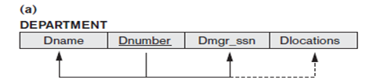
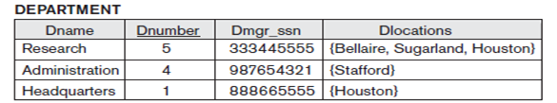
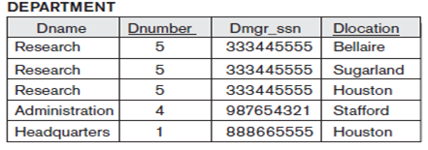
Example Normalization into 1NF
1. Let us Consider following relation Schema Department.
2. Sample State of relation schema Department.
3. 1NF version relation Department with redundancy .

Slide 70
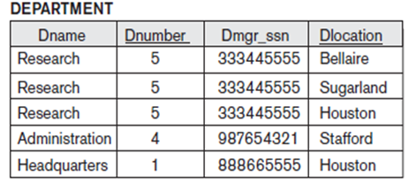
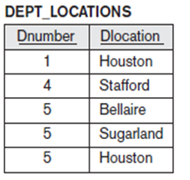
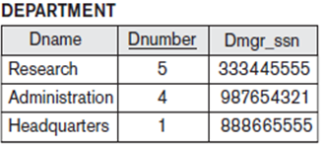
First Normal Form (1NF)
Solution:-
Remove the attribute Dlocations from Department relation that violates 1NF and place it in a separate relation DEPT_LOCATIONS with the primary key {Dnumber, Dlocation}. DEPT_LOCATIONS exists for each location of a department. This decomposes the non-1NF relation into 1NF relations.

Slide 71
2. Second Normal Form (2NF)
Second Normal Form (2NF) is based on the concept of full functional dependency ,and
It also satisfy the following conditions:-
It is in the First Normal Form.
All non-Key attribute are fully functional dependent on the primary key or candidate key of a relation.
Solution
All partial dependencies are removed to place in another relation.

Slide 72
2. Second Normal Form (2NF)
Definition :-
A FD X -> Y is full functional dependency, if removal of any attribute A from X, the dependency does not hold any more.
That is for any attribute A ∈ X,(X-{A}) does not functionally determines Y, else it is partial FD. :- (X-{A}) -> Y(NOT hold )
Examples:-
{SSN, PNUMBER} -> HOURS is a full FD since neither SSN -> HOURS nor PNUMBER -> HOURS hold .
Partial Function Dependency :- A FD X -> Y, is a partial functional dependency if some attribute A ∈ X, can be removed from X and dependency still hold.
A ∈ X, (X-{A}) -> Y(hold )

Slide 73
2. Second Normal Form (2NF)
A relation schema R is in second normal form (2NF) if every non-prime attribute A in R is fully functionally dependent on the primary key or candidate key of R.(means all non key attribute cannot be dependent on a subset of the primary key or candidate key ).
Otherwise ,
R can be decomposed into 2NF relations via the process of 2NF normalization .
Note :- The test for 2NF involves testing for functional dependencies whose left-hand side attributes are part of the primary key. If the primary key contains a single attribute, the test need not be applied at all.
If a primary key is not a composite primary key, such case all non key attribute are always fully dependent on the primary key .

Slide 74
Example 2NF
Let us Consider the following relation schema EMP_PROJ {SSN,Pnumber,hours,ename,pname,plocation}
with FD Set F=
FD1= {SSN,Pnumber} -> hours
FD2= {SSN} -> ename
FD3={Pnumber} -> {Pname,plocation}
Check for 2NF,if it is not in 2NF then converted into 2NF.(Relation have composite primary key {SSN, Pnumber}).

Slide 75
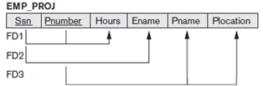
Example 2NF
FD1= {SSN,Pnumber} -> hours (Fully Functional dependency)
FD2= {SSN} -> ename (Partial Functional dependency)
Therefore ename is partial dependent on SSN, which is only the part of the primary key. Therefore FD2 is not satisfied second normal form.
FD3={Pnumber} -> {Pname, plocation} (Partial Functional dependency)
{Pname,Plocation } is also partial dependent on Pnumber, which is only the part of the primary key. Therefore FD3 is not satisfied second normal form
FD1= {SSN,Pnumber} -> hours
FD2= {SSN} -> ename
FD3={Pnumber} -> {Pname,plocation}

Slide 76
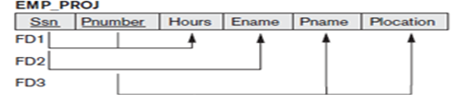



Example
Solution :-
To bring relation EMP_PROJ into second normal form, We decompose the relation

Slide 77
3. Third Normal Form (3NF)
Definition:-
A relation will be in 3NF if it is in 2NF and not contain any transitive partial dependency.
Means ,
Every Non Prime attribute of a relation must be dependent on the primary key.
Note:- An attribute that is not part of any candidate key is known as non-prime attribute.
Transitive Functional Dependency :- If A->B and B->C are two FDs then A->C is called transitive dependency.

Slide 78
3. Third Normal Form (3NF)
A relation schema R is in third normal form (3NF) if it holds atleast one of the following conditions for every FD X -> A holds in R,
X is a super key or,
A is a prime attribute of R. (each element of A is part of some candidate key).
NOTE: Boyce-Codd normal form disallows condition (b) above
(LHS must be super key or candidate key or RHS is a prime attribute).
So any FD’s in relation Schema R must be satisfied at least one above condition otherwise all transitive FD’s non key attribute are removed and placed in another relation.
Example:-
1. {XY -> Z, Y -> X } OK.
2. {XY -> Z, Z -> t} Not OK.

Slide 79

Example 3NF
Let us Consider the following relation schema EMP_DEPT {Ename,SSN,Bdate,address,Dnumber,Dname,Dmgr_ssn} with FD Set
FD1= SSN -> {Ename,Bdate,Address,Dnumber}
FD2= Dnumber -> {Dname, Dmgr_ssn}
Check for 3NF,if it is not in 3NF then converted into 3NF. primary key SSN.

Slide 80
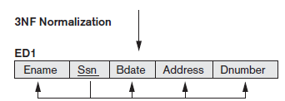

Example 3NF
Solution:-
(primary key of relation EMP_DEPT is SSN)
1. The relation schema EMP_DEPT is in 2NF, since no partial dependencies on a key exist.
2. EMP_DEPT is not in 3NF because of the transitive dependency of DMGRSSN (and also DNAME) on SSN via DNUMBER.
(Dnumber is neither key itself nor a RHS of FD has prime attributes. We can see that dependency of {dname,dmgr_ssn} on Dnumber is undesirable.
How to achieve 3NF?
Hence to apply 3NF we need to decompose the relation EMP_Dept and convert them in to 3NF.

Slide 81
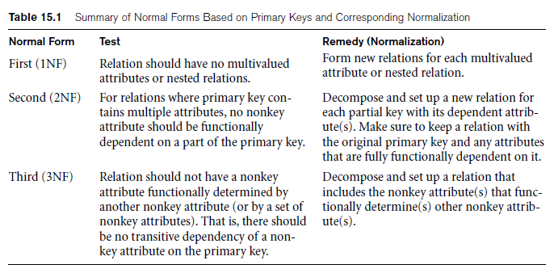
General Definitions of 1NF,2NF and 3NF

Slide 82
4. Boyce Codd Normal Form (BCNF) OR 3.5NF
Boyce-Codd normal form (BCNF) was proposed as a simpler form of 3NF, but it was found to be stricter than 3NF, because every relation in BCNF is also in 3NF; however, a relation in 3NF is not necessarily in BCNF
The official qualification for BCNF are:-
A relation must be in 3NF.
All determinates are super keys,
if determinates are not super key are removed to placed in another relation.
Definition:- A relation schema R is in Boyce-Codd Normal Form (BCNF) if whenever an FD X -> Y holds in R,
A relation R is in BCNF if every functional dependency X → Y, X is the super key of the Relation.
Means
A relation is in BCNF if every determinants is a super key or candidate key .

Slide 83
Continue….
The formal definition of BCNF differs from the definition of 3NF in that clause (b) of 3NF, which allows functional dependency having the RHS as a prime attribute, is absent from BCNF. That makes BCNF a stronger normal form compared to 3NF.
(LHS of every functional dependency must be super key or candidate key and RHS prime attribute condition not allowed in BCNF)
Note:- Every relation in BCNF is in 3NF,but it is not necessary that every relation in 3NF is in BCNF.

Slide 84
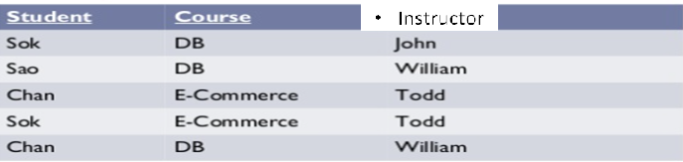
Example
Let us consider the following relation TEACH= {student,Course,Instructor}
with the following dependencies: -
FD1: {Student, Course} → Instructor
FD2: Instructor → Course
{Student, Course}. Check this relation in BCNF or not. is a candidate key for this relation

Slide 85
Example
Instructor is not super keys but determines course. So student relation in 3NF.
But student relation is not in BCNF because in FD Instructor → Course, Instructor is not super key or candidate key or primary key.
Solution :-
Therefore the relation Teach decompose in
1. Teach1 {Student, Instructor}
2. Teach 2 {Instructor, Course}
Teach1 Teach 2

Slide 86

Continue…
All three decompositions will lose functional dependency . We have to settle for sacrificing the functional dependency preservation. But we cannot sacrifice the non-additivity property after decomposition.
Out of the above three, only the 3rd decomposition will not generate spurious tuples after join.(and hence has the non-additivity property).

Slide 87
5. Multi-valued Dependency
Multi-valued dependency (MVD)
Consequence of first normal form (1NF) which diasallow an attribute in a tuple to have a set of values.
A multivalued dependency always requires at least three attributes because it consists of at least two attributes that are dependent on a third attribute .
Let us consider a relation R =(A,B,C) and value of A there is a set of value of B & a set of value of C. However the set of value for B & C are independent of each other.
We write A →→ B and
A →→ C.

Slide 88
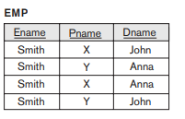
Example
Example :- Employee whose name is ename work on project Pname and has dependent dname. An employee may work on several projects and have several dependents & both project and dependents are independent from each other.
problem
Multivalued dependencies (MVDs) express a condition among tuples of a relation that exists when the relation is trying to represent more than one to many or many to many relationship.

Slide 89
Formal Definition of Multivalued Dependency
A multivalued dependency X →→ Y specified on relation schema R, where X and Y are both subsets of R, specifies the following constraint on any relation state r of R:
If two tuples t1 and t2 exist in r such that t1[X] = t2[X], then two tuples t3 and t4 should also exist in r with the following properties,
t1[X] = t2[X] = t3[X] = t4[X]
t1[Y] = t3[Y] and t2[Y] = t4[Y]
t1[Z] = t4[Z] and t3[Z] = t2[Z]
Where X →→ Y holds, we say that X multi-determines Y, or Y is multi-dependent on X.

Slide 90
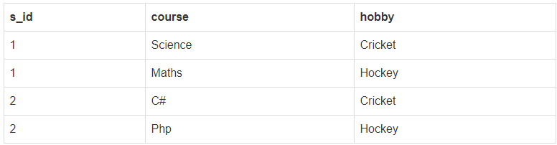
Forth Normal Form (4NF)
The official qualification for 4NF are:-
A table is already in BCNF.
A table contain no multi-valued functional dependency .
Example :- Let us consider following relation student:-
Key:- {s_id,course,hobby}
MVD, s_id →→ course,hobby
To check relation is in 4NF or not.

Slide 91
Example
As you can see in the above table , student with s_id 1 has opted for two courses, Science and Maths, and has two hobbies, Cricket and Hockey.
You must be thinking what problem this can lead to, right?
Problem:- Well the two records for student with s_id 1& 2, will give rise to two more records, because for one student, two hobbies exists, hence along with both the courses, these hobbies should be specified.

Slide 92
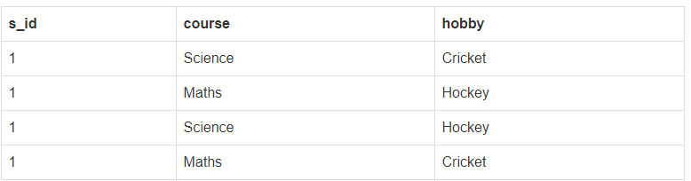
Continue
In the above table , there is no relationship between the columns course and hobby. They are independent of each other.
So there is multi-value dependency, which leads to un-necessary repetition of data and other anomalies as well.

Slide 93

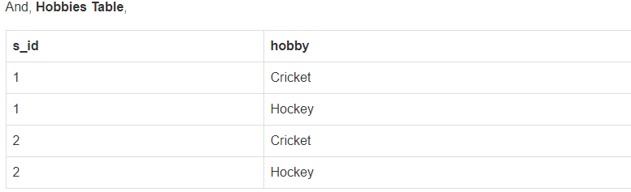
Solution
Solution:- To make the above relation satisfy the 4th normal form, we can decompose the table into 2 tables.
Now this relation satisfies the fourth normal form.

Slide 94
6. Fifth Normal Form (5NF)
The 5NF (Fifth Normal Form) is also known as project-join normal form (PJNF).
A relation is in Fifth Normal Form (5NF), if
it is in 4NF, and
won’t have lossless decomposition into smaller tables.
Definition:- A join dependency (JD), denoted by JD(R1, R2, … , Rn), specified on relation schema R, specifies a constraint on the states r of R.
The constraint states that every legal state r of R should have a non-additive join decomposition into R1, R2, … , Rn.
Hence, for every such r we have * (πR1 (r), πR2 (r), … , πRn (r)) = r

Slide 95
6. Fifth Normal Form (5NF)
5NF is of little practical use to the database designer, but it is of interest from a theoretical point of view.
In all of the further normal forms discussed so far, no loss decomposition was achieved by the decomposing of a single table into two separate tables.
Note :- In considering 5NF, consideration must be given to tables where this non-loss decomposition can only be achieved by decomposition into three or more separate tables.

Slide 96
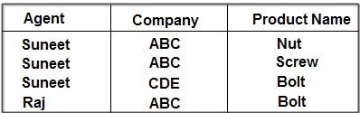
Example
Let us consider the following relation person with attribute ((Agent, Company, Product _Name))
The table is in 4NF because it contains no multi-valued dependency.
It does, however, contain an element of redundancy in that it records the fact that Suneet is an agent for ABC twice. But there is no way of eliminating this redundancy without losing information.

Slide 97
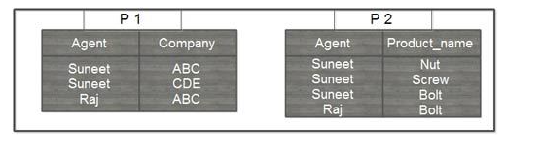
Continue
Suppose that the Relation Person is decomposed into two relation P1 and P2.
The redundancy has been eliminated, but the information about which companies make which products and which of these products they supply to which agents has been lost.

Slide 98
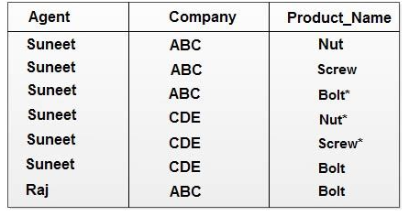
Continue..
The natural join of these projections over the ‘agent’ columns is:
The table resulting from this join is spurious, since the asterisked row of the table contains incorrect information.
Solution :- When we decompose the relation such case common attribute must be a candidate key.

Slide 99
Cont……..
Now suppose that the original table were to be decomposed into three tables, the two projections, P1 (agent,company)and P2(agent,procduct) which have already shown, and the final, possible projection, P3 (company,product). P3
Company | Product_name
ABC | Nut
ABC | Scew
CDE | Bolt
ABC | Bolt

Slide 100
Conti….
If a join is taken of all three projections, first of P1 and P2 with the (spurious) result shown above, and then of this result with P3 over the ‘Company’ and ‘Product name’ column, the following table is obtained:-
This still contains a spurious row. The order in which the joins are performed makes no difference to the final result. It is not simply possible of decompose the ‘AGENT_COMPANY_PRODUCT’ table, populated as shown, without losing information. Thus, it has to be accepted that it is not possible to eliminate all redundancies using normalization techniques, because it cannot be assumed that all decompositions will be non-loss.
Agent | Company | Product_Name
Suneet | ABC | Nut
Suneet | ABC | Screw
Suneet | ABC | Bolt
Suneet | CDE | Bolt
Raj | ABC | Bolt

Slide 101
Content
Lecture 8:-
Decomposition of relation Schema
Properties of decomposition

Slide 102
Decomposition of relation Schema
Decomposition of relation schema R consists of replacing the relation schema by two or more sub relations schemas. So that each contain subset of attributes of relation schema R and which together include all attribute or R.
Decomposition of relation R= {A1,A2,A3,…….An} is the replacement of R by a collection D={R1,R2…….Rm} where Ri is subset of R such that R={ R1 U R2 U…….RN}
Example :- R= { Eid,position,salary}
D1= {Eid,position}
D2= {Postion,Salary}
Using the functional dependencies we can decompose a given relation schema R= {A1,A2,……AN} into a set of relation schema represented by D={R1,R2…..RN} to remove anomalies present in a database(Relations).

Slide 103
Properties of decomposition
There are three properties of decomposition of relation are
Attribute Preservation
Dependency Preservation
Lossless Join decomposition

Slide 104
Attribute Preservation
We must make sure that each attribute in R will appear in at least one relation schema Ri in the decomposition so that no attributes are lost; formally, we say this is called attribute preservation.
Example :- R={A,B,C,D,E,F}
Decompose relation are
R1={A,B,C,D}
R2={A,E,F}
Note :- Union of all decompose relation will give all attribute of universal relation R.
R1 U R2= R{A,B,C,D,E,F}.

Slide 105
2. Dependency Preservation
It would be useful if each functional dependency X → Y specified in F either appeared directly in one of the relation schemas Ri in the decomposition D or could be inferred from the dependencies that appear in some Ri. Informally, this is the dependency preservation condition.
We want to preserve the dependencies because each dependency in F represents a constraint on the database. If one of the dependencies is not represented in some individual relation Ri of the decomposition, we cannot enforce this constraint by dealing with an individual relation.

Slide 106
Cont….. (CO3)
If we decompose a relation R into relations R1 and R2, All dependencies of R either must be a part of R1 or R2 or must be derivable from combination of FD’s of R1 and R2.
A Decomposition D = { R1, R2, R3….Rn } of R is dependency preserving write E a set F of Functional dependency if
(F1 ∪ F2 ∪ … ∪ Fm) ⁺ = F⁺ .

Slide 107
Cont….. (CO2)
A Dependency preserving decomposition of a relation R is R1, R2, R3...Rn concerning the set of Functional Dependencies FD if,
(FD1 ∪ FD2 ∪ ... ∪ FDn)+ = FD+
where,
FD1, FD2, FD3…...FDn Sets of Functional dependencies of relations R1, R2, R3 ...Rn.
(FD1 U FD2 U FD3 U … U FDn)+ -> Closure of Union of all sets of functional dependencies.
FD+ -> Closure of set of functional dependency FD of R.
With FD (FD1) R is decomposed or divided into R1 and with FD(FD2) into R2, then the possibility of three cases arise,
FD1 ∪ FD2 = FD -> Decomposition is dependency preserving.
FD1 ∪ FD2 is a subset of FD -> Not Dependency preserving.
FD1 ∪ FD2 is a superset of FD -> This case is not possible.

Slide 108
Example
Let suppose, a relation R (P, Q, R, S) with a set of Functional Dependency FD = (PQ→R, R→S, S→P) is given. Into R1 (P, Q, R) and R2(R, S), relation R (P, Q, R, S) is decomposed. Find out whether the decomposition is dependency preserving or not.
Solution:
Decomposed relations of relation R (P, Q, R, S) are R1 (P, Q, R) and R2 (R, S). To solve this problem, we need to first find the closure of Functional Dependencies FD1 and FD2 of the relations R1 (P, Q, R) and R2(R, S).
To find the closure of FD1, we have to consider all combinations of (P, Q, R). i.e., we need to find out the closure of P, Q, R, PQ, QR, and RP.

Slide 109
Example cont..
closure (P) = {P} // Trivial
closure (Q) = {Q} // Trivial
closure (R) = {R, P, S} //but S can't be in closure as S is not
//present in R1 (P, Q, R).
= {R, P}
(R--> P // Removing R from right side as it is trivial attribute)
closure (PQ) = {P, Q, R, S}
= {P, Q, R}
(PQ --> R // Removing PQ from right side as these are trivial attributes)
closure (QR) = {Q, R, S, P}
= {P, Q, R}
(QR --> P // Removing QR from right side as these are trivial attributes)
Closure (PR) = {P, R, S}
(PR --> S // Removing PR from right side as these are trivial attributes)
FD1 {R --> P, PQ --> R, QR --> P}.
..

Slide 110
Example cont..
2) Similarly FD2 {R--> S}
In the original Relation Dependency FD= {PQ→R, R→S, S→P}.
PQ --> R is present in FD1.
R --> S is present in FD2.
S --> P is not preserved.
From the given result, in FD1, PQ holds R (PQ --> R) and in FD2, R holds S (R --> S). But, there is no follow up in Functional Dependency S holds P (S --> P).
FD1 U FD2 is a subset of FD.
So as a consequence, given decomposition is not dependency preserving.

Slide 111
Nonadditive (Lossless) Join Property of a Decomposition
Another property that a decomposition D should possess is the nonadditive join property, which ensures that no spurious tuples are generated when a NATURAL JOIN operation is applied to the relations resulting from the decomposition.
Definition. Formally, a decomposition D = {R1, R2, … , Rm} of R has the lossless (nonadditive) join property with respect to the set of dependencies F on R if, for every relation state r of R that satisfies F, the following holds, where * is the NATURAL JOIN of all the relations in D: *(πR1(r), … , πRm(r)) = r.

Slide 112
Procedure
Procedure :- Decomposition of R into R1 and R2 from a lossless join decomposition if at least one of the following dependencies in F⁺
First condition) = (ABC) U (AD) = (ABCD) = Att(R). holds true as Att(R1) U Att(R2
R1 ∩ R2= R1 , that is: all attributes common to both R1 and R2 functionally determine ALL the attributes in R1.
OR
R1 ∩ R2= R2 that is: all attributes common to both R1 and R2 functionally determine ALL the attributes in R2
3. In other word R1 ∩ R2 from a super key or candidate key of either R1 or R2 or both , The decomposition of R is a lossless join decomposition.

Slide 113
Problem- 1
Problem-01: Consider a relation schema R ( A , B , C , D ) with the functional dependencies A → B and C → D. Determine whether the decomposition of R into R₁ ( A , B ) and R₂ ( C , D ) is lossless or lossy.
Solution-
Condition-01:
According to condition-01, union of both the sub relations must contain all the attributes of relation R.
So, we have-
R₁ ( A , B ) ∪ R₂ ( C , D )
= R ( A , B , C , D )
Clearly, union of the sub relations contain all the attributes of relation R.
Thus, condition-01 satisfies.

Slide 114
Problem- 1
Condition-02:
According to condition-02, intersection of both the sub relations must not be null.
So, we have-
R₁ ( A , B ) ∩ R₂ ( C , D )
= Φ
Clearly, intersection of the sub relations is null.
So, condition-02 fails.
Thus, we conclude that the decomposition is lossy.

Slide 115
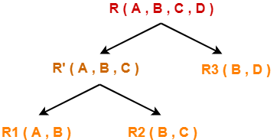
Problem-2
Problem-02:Consider a relation schema R ( A , B , C , D ) with the following functional dependencies-
{ A → B
B → C
C → D
D → B
Determine whether the decomposition of R into R₁ ( A , B ) , R₂ ( B , C ) and R₃ ( B , D ) is lossless or lossy.
Solution-
Consider the original relation R was decomposed into the given sub relations as shown-

Slide 116
Problem-2
Decomposition of R(A, B, C, D) into R'(A, B, C) and R₃(B, D)-
Condition-01:
According to condition-01, union of both the sub relations must contain all the attributes of relation R.
So, we have-
R‘ ( A , B , C ) ∪ R₃ ( B , D )
= R ( A , B , C , D )
Clearly, union of the sub relations contain all the attributes of relation R.
Thus, condition-01 satisfies.

Slide 117
Problem-2
Condition-02:
According to condition-02, intersection of both the sub relations must not be null.
So, we have-
R‘ ( A , B , C ) ∩ R₃ ( B , D )
= B
Clearly, intersection of the sub relations is not null.
Thus, condition-02 satisfies.

Slide 118
Problem-2
Condition-03:
According to condition-03, intersection of both the sub relations must be the super key of one of the two sub relations or both.
So, we have-
R‘ ( A , B , C ) ∩ R₃ ( B , D )
= B
Now, the closure of attribute B is- B⁺ = { B , C , D }
Now, we see-
Attribute ‘B’ can not determine attribute ‘A’ of sub relation R’.
Thus, it is not a super key of the sub relation R’.
Attribute ‘B’ can determine all the attributes of sub relation R₃.
Thus, it is a super key of the sub relation R₃.
Clearly, intersection of the sub relations is a super key of one of the sub relations. So, condition-03 satisfies.
Thus, we conclude that the decomposition is lossless.

Slide 119
Problem-2
Decomposition of R'(A, B, C) into R₁(A, B) and R₂(B, C)-
Condition-01:
According to condition-01, union of both the sub relations must contain all the attributes of relation R’.
So, we have-
R₁ ( A , B ) ∪ R₂ ( B , C )
= R’ ( A , B , C )
Clearly, union of the sub relations contain all the attributes of relation R’.
Thus, condition-01 satisfies.
Condition-02:
According to condition-02, intersection of both the sub relations must not be null. So, we have-
R₁ ( A , B ) ∩ R₂ ( B , C )
= B
Clearly, intersection of the sub relations is not null.
Thus, condition-02 satisfies.

Slide 120
Problem-2
Condition-03:
According to condition-03, intersection of both the sub relations must be the super key of one of the two sub relations or both.
So, we have-
R₁ ( A , B ) ∩ R₂ ( B , C )
= B
Now, the closure of attribute B is-
B⁺ = { B , C , D }
Now, we see-
Attribute ‘B’ can not determine attribute ‘A’ of sub relation R₁.
Thus, it is not a super key of the sub relation R₁.
Attribute ‘B’ can determine all the attributes of sub relation R₂.
Thus, it is a super key of the sub relation R₂.
Clearly, intersection of the sub relations is a super key of one of the sub relations.

Slide 121
Problem-2
So, condition-03 satisfies.
Thus, we conclude that the decomposition is lossless.
Conclusion-
Overall decomposition of relation R into sub relations R₁, R₂ and R₃ is lossless.

Slide 122
Testing for Non additive join property
A Universal relation R , decomposition D {R1,R2,……Rm} of R and a set of Functional dependencies
Step 1:- Create a matrix by the given set of FD’s (initially matrix will one row i for each relation Ri in D, and one column J for each attribute Aj in R ).
Step 2:- Set s(i,j) = by for all matrix entries:-
Put the symbol ‘a’ for those element which are present in the given set D. And
Put the symbol ‘b’ for those element which are not present in the given set D.
Setp3:- Now apply the given FD’s and developed new matrix by changing the symbol ‘b’ to ‘a’ if the element functionally dependent.
Step 4:- Check whether any raw is filled with all ‘a’.
Step 5:- if any raw is filled with all ‘a’ element then It is lossless join decomposition otherwise lossy decomposition.

Slide 123
Example
Question 1:- Let us consider a relation Schema R ={SSN, PNumber, PName, PLocation,Hours} and functional dependency set f=
SSN –> Ename,
Pnumber –> {Pname,Plocation}
{SSN,Number} –> Hours } and
Decompose a relation D = {R1,R2,R3} where R1= {SSN, Ename}, R2= {Pnumber, Pname,Plocation} and R3= {SSN, Pnumber, Hours} .
show whether decomposition is lossy or lossless join decomposition .

Slide 124
Question 2:- Let us consider a relation Schema R ={A,B,C,D,E,} and functional dependency set f=
AB –> CD,
A –> E
C –> D } and
Decompose a relation D = {R1,R2,R3} where R1= {A,B,C}, R2= {B,C,D}, and R3= {C,D,E} .
show whether decomposition is lossy or lossless join decomposition .

Slide 125
Inclusion Dependencies
MVDs and JDs can be used to guide database design, as we have seen, although they are less common than FDs and harder to recognize and reason about.
In contrast, inclusion dependencies are very intuitive and quite common. However, they typically have little influence on database design
The main point to bear in mind is that we should not split groups of attributes that participate in an inclusion dependency.
Most inclusion dependencies in practice are key-based, that is, involve only keys.

